Slide 1
BUILDING NEURAL NETWORK
SHASHANK KHOT
SWATHI PADITHALA
Date : 8th Feb 2022
Neural networks reflect the behavior of the human brain, allowing computer programs to recognize patterns and solve common problems in the fields of AI, machine learning, and deep learning.

Slide 2
What are neural networks?
Neural networks, also known as artificial neural networks (ANNs) or simulated neural networks (SNNs), are a subset of machine learning and are at the heart of deep learning algorithms. Their name and structure are inspired by the human brain, mimicking the way that biological neurons signal to one another.
Artificial neural networks (ANNs) are comprised of a node layers, containing an input layer, one or more hidden layers, and an output layer. Each node, or artificial neuron, connects to another and has an associated weight and threshold. If the output of any individual node is above the specified threshold value, that node is activated, sending data to the next layer of the network. Otherwise, no data is passed along to the next layer of the network.
Neural networks rely on training data to learn and improve their accuracy over time. However, once these learning algorithms are fine-tuned for accuracy, they are powerful tools in computer science and artificial intelligence, allowing us to classify and cluster data at a high velocity. Tasks in speech recognition or image recognition can take minutes versus hours when compared to the manual identification by human experts. One of the most well-known neural networks is Google’s search algorithm.

Slide 3
Types of neural networks
The perceptron is the oldest neural network, created by Frank Rosenblatt in 1958. It has a single neuron and is the simplest form of a neural network:
Feedforward neural networks or multi-layer perceptrons (MLPs), are comprised of an input layer, a hidden layer or layers, and an output layer and it’s important to note that they are comprised of sigmoid neurons. As we seen in example sata usually is fed into these models to train them, and they are the foundation for computer vision, natural language processing, and other neural networks.
Convolutional neural networks (CNNs) are similar to feedforward networks, but they’re usually utilized for image recognition, pattern recognition, and/or computer vision. These networks harness principles from linear algebra, particularly matrix multiplication, to identify patterns within an image.
Recurrent neural networks (RNNs) are identified by their feedback loops. These learning algorithms are primarily leveraged when using time-series data to make predictions about future outcomes, such as stock market predictions or sales forecasting.

Slide 4
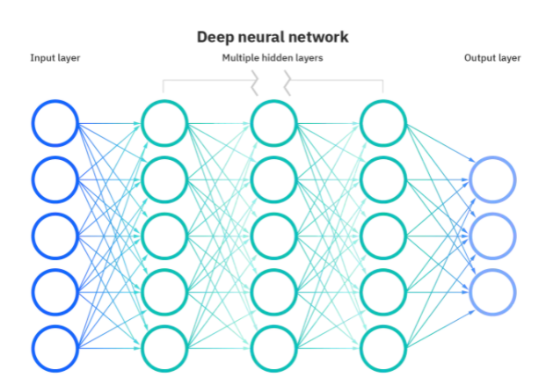
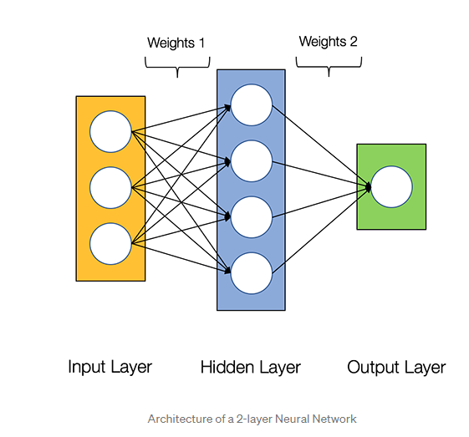
deep learning Vs neural networks
Deep Learning and neural networks tend to be used interchangeably in conversation, which can be confusing. As a result, it’s worth noting that the “deep” in deep learning is just referring to the depth of layers in a neural network. A neural network that consists of more than three layers—which would be inclusive of the inputs and the output—can be considered a deep learning algorithm. A neural network that only has two or three layers is just a basic neural network.

Slide 5
High Level Architecture
Neural Networks consist of the following components
An input layer, x
An arbitrary amount of hidden layers
An output layer, ŷ
A set of weights and biases between each layer, W and b
A choice of activation function for each hidden layer, σ. In this tutorial, we’ll use aSigmoid activation function.
Naturally, the right values for the weights and biases determines the strength of the predictions. And the process of fine-tuning the weights and biases from the input data Is known as training the Neural Network.
Each iteration of the training process consists of the following steps:
Calculating the predicted output ŷ, known as feedforward
Updating the weights and biases, known as backpropagation

Slide 6
How do neural networks work?
Think of each individual node as its own linear regression model, composed of input data, weights, a bias (or threshold), and an output. The formula would look something like this:
∑wixi + bias = w1x1 + w2x2 + w3x3 + bias
output = f(x) = 1 if ∑w1x1 + b>= 0; 0 if ∑w1x1 + b < 0
Once an input layer is determined, weights are assigned. These weights help determine the importance of any given variable, with larger ones contributing more significantly to the output compared to other inputs.
All inputs are then multiplied by their respective weights and then summed. Afterward, the output is passed through an activation function, which determines the output.
If that output exceeds a given threshold, it “fires” (or activates) the node, passing data to the next layer in the network.
This results in the output of one node becoming in the input of the next node. This process of passing data from one layer to the next layer defines this neural network as a feedforward network.

Slide 7

Example : should we order PIZZA?
From there, let’s apply it to a more tangible example, like whether or not you should order a pizza for dinner. This will be our predicted outcome, or y-hat. Let’s assume that there are three main factors that will influence your decision:
If you will save time by ordering out (Yes: 1; No: 0)
If you will lose weight by ordering a pizza (Yes: 1; No: 0)
If you will save money (Yes: 1; No: 0)
Then, let’s assume the following, giving us the following inputs:
X1 = 1, since you’re not making dinner
X2 = 0, since we’re getting ALL the toppings
X3 = 1, since we’re only getting 2 slices
For simplicity purposes, our inputs will have a binary value of 0 or 1.

Slide 8

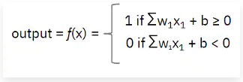
Weights, bias and activation
We now need to assign some weights to determine importance. Larger weights make a single input’s contribution to the output more significant compared to other inputs.
W1 = 5, since you value time
W2 = 3, since you value staying in shape
W3 = 2, since you've got money in the bank
Finally, we’ll also assume a threshold value of 5, which would translate to a bias value of –5.
Since we established all the relevant values for our summation, we can now plug them into the formula we previously learned
Activation function, we can now calculate the output
(i.e., our decision to order pizza):

Slide 9
summary
With all the various inputs, we can start to plug in values into the formula to get the desired output
Y-hat (our predicted outcome) = Decide to order pizza or not
Y-hat = (1*5) + (0*3) + (1*2) - 5
Y-hat = 5 + 0 + 2 – 5
Y-hat = 2, which is greater than zero.
Since Y-hat is 2, the output from the activation function will be 1, meaning that we will order pizza.
If the output of any individual node is above the specified threshold value, that node is activated, sending data to the next layer of the network. Otherwise, no data is passed along to the next layer of the network.
Now, imagine the above process being repeated multiple times for a single decision as neural networks tend to have multiple “hidden” layers as part of deep learning algorithms. Each hidden layer has its own activation function, potentially passing information from the previous layer into the next one.
Once all the outputs from the hidden layers are generated, then they are used as inputs to calculate the final output of the neural network.

Slide 10
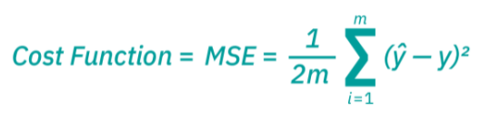
GOAL
As we start to think about more practical use cases for neural networks, like image recognition or classification, we’ll leverage supervised learning, or labeled datasets, to train the algorithm. As we train the model, we’ll want to evaluate its accuracy using a cost (or loss) function. This is also commonly referred to as the mean squared error (MSE). In the equation below,
i represents the index of the sample,
y-hat is the predicted outcome,
y is the actual value, and
m is the number of samples.
Ultimately, the goal is to minimize our cost function to ensure correctness of fit for any given observation.
As the model adjusts its weights and bias, it uses the cost function and reinforcement learning to reach the point of convergence, or the local minimum.
The process in which the algorithm adjusts its weights is through gradient descent, allowing the model to determine the direction to take to reduce errors (or minimize the cost function). With each training example, the parameters of the model can be adjust to gradually converge at the minimum.

Slide 11

DSBA 6165: AI & DL
Text to Speech Voice Cloning
By:
Shashank Khot
Swathi Padithala

Slide 12
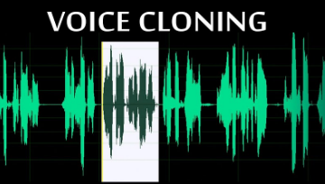
Generating Voice that sounds Real
Create speech that's identical from the original speaker.
A neural network-based system for text-to-speech (TTS) synthesis that can generate speech audio in the voice of different speakers

Slide 13
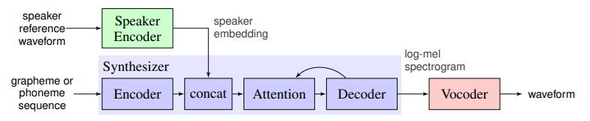
Task Flow
Speaker encoder is used to condition the synthesis network on a reference speech signal from the desired target speaker
The synthesizer is trained on pairs of text transcript and target audio
WaveNet-based vocoder network that converts the mel spectrogram into time domain waveform samples

Slide 14
Training : Data Sets
Used Two public datasets for training the speech synthesis and vocoder networks
VCTK contains 44 hours of clean speech from 109 speakers
Tiny_shakespeare

Slide 15
Design Mock Up
Automatic speech recognition of what is said in the file. E.g. converting audio to text
Adding punctuation and capitalization to the text
Generating spectrogram from resulting text
Generating waveform audio from the spectrogram.

Slide 16
Algorithm Working
Speech Recognition model
Spectrogram generator which takes text as an input and produces spectrogram
Vocoder model which takes spectrogram and produces actual audio
Convert our audio sample to text
Add capitalization and punctuation
A helper function which combines Tacotron2 and WaveGlow to go directly from text to audio
original audio sample Vs. punctuation model changed audio

Slide 17
Conclusion
Model is able to generate realistic speech from text using the selected base voice.

Slide 18
References
Transfer Learning from Speaker Verification to Multi-speaker Text-To-Speech Synthesis
Voice Cloning Using Deep Learning
NeMo voice swap app

Slide 19
Thank You!

